Slide 1
Speech to Sign language translation for E-learning
Team Guide : Dr. Amit Mishra
Team Members : Prachi Bhatt (19BAI10111)
Toshini Agrawal (19BAI10115)
Shivangi Singh (19BAI10097)
Notes:
s

Slide 2

INTRODUCTION
Since the COVID -19 pandemic has disrupted the conventional life style of individuals across the world, the virtual world has come to the rescue. Amongst several educational establishments faculties have shifted their base to virtual platforms to conduct classes online. But there are many students around the globe who struggle to attend their online classes properly because of reasons like internet connectivity issue, not having proper devices, not having proper place to study etc..
But there are people who struggle to understand what’s being taught in the virtual classes because of certain sensory,cognitive or functional disabilities.
Specifically, individuals with hearing impairments, with partial or complete loss of hearing are prevented from participating in live (synchronous) cooperative e-learning activities, because of the common reliance on voice communication in such activities. whereas speech-to-text systems offer an eventual pathway for the Deaf individuals to follow the communication, it doesn't enable them to participate within the same mode. Not all deaf individuals have the same communication skills: some people communicate using oral language and/or writing and lip-reading, whereas others use Sign Language. Some are bilingual deaf people that use both kinds of communication.
Notes:
1. WHY ISL - no other SL like ASL, BSL(diversity factor)
2. STATISTICS – increase in deaf community members with time.
3. ROLE of ISL.
4. Role and significance of technology for communication and learning among Deaf Community.
5. General methodology of proposed system.

Slide 3
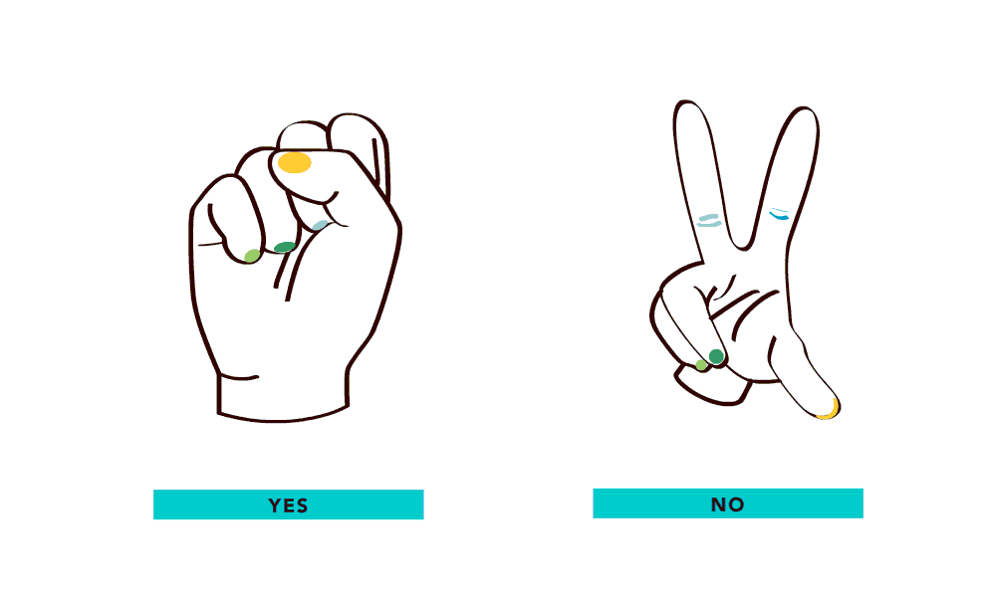
Nowadays, to make video streaming on the internet more accessible for everyone, people are using different ways to achieve this, such as adding captions in videos, including audio description or adding transcript to videos which are helpful for people with hearing impairment. We want to make streaming videos a bit more accessible for everyone by using our app.
In our app we are going to use Sign language to help people with hearing impairment. Our app takes audio as an input and converts it into Indian Sign Language. With our app we hope to make virtual world a better facility for the hearing impaired individuals . Our app aims to get rid of communication barriers by creating the audio track content from online videos obtainable to hearing-impaired people by mechanically generating a video-based speech to signing translation.
Our app will be easy to use and easily accessible for everyone.
Notes:
s

Slide 4

Existing work with limitations
In India, there are no app that converts audio to Indian Sign Language.
There are a lot of apps available that teach Indian Sign Language but they do not convert audio to Indian Sign Language.
The existing apps don’t convert audio to Sign language real time, they convert one sentence at a time.
Our app will be ad-free.
“Hello”
Notes:
s

Slide 5

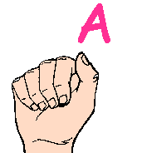
About our framework:-
User’s Video
Our app works in split screen mode.
As shown in the figure, the above part is the user’s video (for eg: online lectures) and below it is our app which is translating the audio from the video to ISL in real time.
App translating the video’s audio to ISL in real time
Split Screen on phone
Notes:
s

Slide 6

Proposed work
Logo page
Login page
Pop outs of App permissions
Welcome page {welcome phrase.}
Directions to use split screen mode in android
Video lecture
Split screen view
Indian sign language (2 hands)
Notes:
p

Slide 7


Methodology
Audio (input) as dataset
Recognition(the technology needed to capture and interpret audio)
Synchronous translation
(LSTM)-(speech-to-sign language)
Representation(Animated hands interpreting audio)
Notes:
p

Slide 8
Continue…..
Speech-to-Sign Language Translation
Recognition
(to capture and interpret data)
Audio (input) as dataset
Synchronous translation
Representation
Animated hands gestures (ISL)
Data Selection
Pre -processing
Transformation
Deep learning algorithm
Deep learning algorithm
Notes:
p

Slide 9
Continue…..
Here are some important considerations while choosing an algorithm.
Size of training data -choosing the algorithms with high bias /low variance depending on size of dataset.
Accuracy and Interpretability of output
Speed or training time-algorithms which should be easy to implement and quick to respond.
Linearity-prioritise linear data but if not then algorithms who can handle complex data without providing high residual errors.
Number of features:- choosing algorithm which can reduce dimensionality and select important features.
Notes:
p

Slide 10
Novelty of the project
It implements Speech-to-sign language translation for e-learning using Indian Sign Language .
Synchronous translation of live lectures from speech to indian sign language
Our App is free which does not contain premium packages which are very costly for users to afford.​
Notes:
t

Slide 11
Real time usage
This system is designed notably for deaf people for the purpose of educational objectives(e - learning).
The high level of visualisation allows the user to be able to interpret the video lecture(audio) logic seeing animated hands.
The synchronous translation of the app makes the user to understand the lecture without any lagging between animated hands and audio.
Notes:
t

Slide 12
Software requirements (for user)
•Processor:
Minimum 1 GHz; Recommended 2 GHz or more​
•Ethernet connect strongly action (LAN) OR a wireless adapter (Wi-Fi)​
•Hard Drive:
Minimum 32 GB; Recommended 64 GB or more​
•Memory (RAM):
Minimum 1 GB; Recommended 4 GB or above​
•Sound card w/speakers​
Notes:
t

Slide 13
Hardware and Software requirements (for developer
Hardware Requirements:​
It is highly recommend to use at least 4 GB ram or higher.
better processor like i5 or i7.​
GPU for training the deep learning models efficiently.
And last, if you have a good android device​(8+) or iOS(10+) for testing and debugging.
Notes:
t

Slide 14
Software Requirements : (for developer)
FRONTEND-
java SDK and ândroid studio IDE (with SDK bundle)
Visual Studio Code.
BACKEND-
Python 3.8.x or latest is preferred.
Browser supporting Javascript Web Speech API
Tensorflow workstation or Opencv
pyAudio
MongoDB
Blender 3D tool
Notes:
t

Slide 15
TECHNICAL REQUIREMENTS
An important challenge of the project is to achieve a minimum level of quality of the technology, because the usability of the developed systems will depend on that quality. The following technologic requirements are defined:
─ Speech recognition system will demand a recognition rate higher than 90% in the selected application domain. If that rate is not reached with speaker-independent models, an adaptation process will be performed to each speaker involved in the evaluation in order to guarantee that rate.
─ It is also necessary a translation rate higher than 90% for the application domains targeted in the project. In order to obtain that translation rate, several translation strategies will be analyzed and combined.
Notes:
s

Slide 16
Continue…….
Finally, it is necessary an intelligibility of the avatar of 90% when representing the signs: recognition rate of deaf people. In order to obtain this intelligibility, the sign generation uses techniques based on inverse kinematics and semi-automatic movement capture that lets to obtain more realistic movements. This approximation requires more time for the dictionary generation, but it is more realistic.
Notes:
s

Slide 17
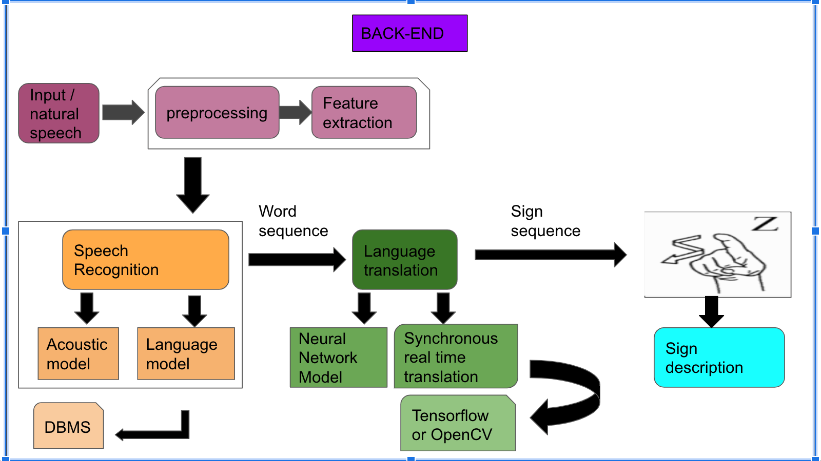
Overall System Architecture and Diagram
FRONT-END
FRONT-END
User
Login page
Welcome page {welcome phrase.}
Pop outs of App permissions
Video lecture
Directions to use split screen mode in android
Split screen view
ISL-hand animation
Notes:
p+t

Slide 18

First Review

Slide 19
Continuation with Zeroth Review
In the zeroth review we presented our idea on how our app will work and how it will help the hearing imapired community.
To summarize, we are making an app that takes audio as an input and converts it into Indian Sign Language.
The audio can be taken from an ongoing virtual meeting or some kind of video playing on the phone.
Our app is used in split screen mode so that the user can see the video as well as understand the audio of the video through sign language.
The proposed idea during the zeroth review was that the audio is taken from the video as an input then converted into text using google API and the text is then converted into animated hand gesture.

Slide 20
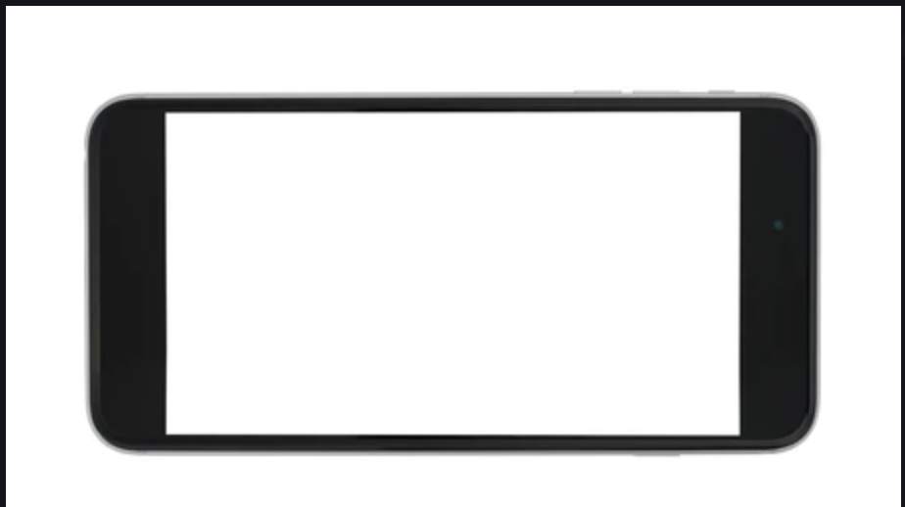
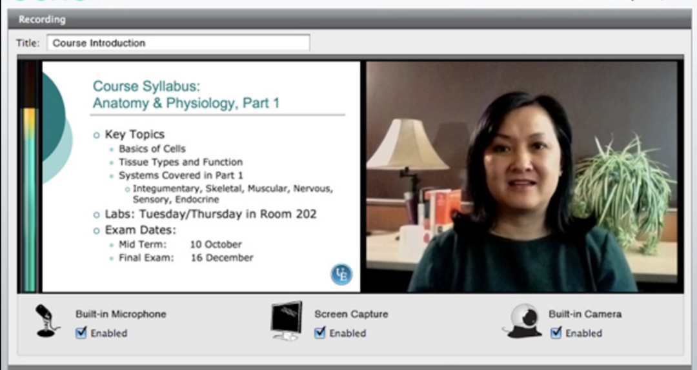


Proposed App Image

Slide 21
Literature review
Paper 1: http://www.typoday.in/2016/spk_papers/Nakul_Singal_TypographyDay-2016.pdf
Written by: Nakul Singal
Authors of Paper[1] mentioned that India has the largest Deaf population in the world. Perhaps “one of every five people who are deaf in the world, live in India” as the country with the large number of deaf people so it is highly important to use some mode of communication between deaf people and normal people hence sign language is required But still ISL is in developing stage.Hence because of these our research to develop a learning system will totally based on indian sign language to gain the status of sign language as a minority language.
Paper 2: https://www.govtech.com/magazines/gt/Speech-Recognition-vs-Speaker-Recognition-.html
Written by: Peter M. Hermsen
Paper[2] reports on an investigation how VCs and instructors are working on identifying the barriers and problems of distant learning for deaf students managing them effectively in King Saud University (KSU) as during COVID-19 pandemic schools are shut down so, there is sudden need for some system which is capable of providing effective distant learning. Hence our research will directly help in solving the problems in this field.

Slide 22
Contd...
Paper 3 https://www.researchgate.net/publication/222429404_Speech_to_sign_language_translation_system_for_Spanish
Written by: Ruben Hernandez, Roberto Barra-Chicote, Ricardo Cordoba, Luis Fernando D'Haro
An architecture was proposed in [3],It was a speech-to-gesture translator and it was divided into four modules namely, speech recogniser,semantic analysis, gesture sequence generation and gesture sequence animation.The main work was done on gestures generation and animation.The phoenix parser was used for the semantic analysis.The drawbacks include how the designer chose a finite set to perform the gesture animation and were not able to generate all the possible positions of a gesture.
Paper 4: https://www.researchgate.net/publication/221365167_V2S_Voice_to_Sign_Language_Translation_System_for_Malaysian_Deaf_People
Written by: Oi-Mean Foong, Tang Jung Low, Wai Wan La
Paper[4], says , The development of this V2S system as an alternative solution to reduce the cost of employing special skilled employees for media agencies. In their work they used three stages in proposed work : A.Sound Recording – for capturing and recording the sound using a microphone. B. Digital Signal Processing – The “trained” sound from the sound recording is then fed into the Digital Signal Processing(DSP) part.C. Vector Quantization
Notes:
Paper 4:– Vector quantization is used to perform speech recognition. The main drawback of V2S is, it only act as as an interpreter considering economic factors but the main need of current time is education for deaf people by introducing an efficient e learning application using ISL

Slide 23
Module description
Module 1: Android features
This module consist of :-
Interactive Environment
Authentication.
Welcome Activity
User guide on how to split the screen
Home
Books
Notes
Module 2: Recognition
Using Google API , the audio from the video in converted into text
Module 4: Representation
In this module the converted Indian Sign Language is converted into animated hand signs.
Module 3 : Translator
In this module the text is converted to Indian Sign Language.

Slide 24
Module workflow explanation
Module 1
Module 2
MODULE 1 :
STEP 1 : Installing speech-Indian sign language Application
STEP 2 : First Screen appears for 3 secs.(Logo page)
STEP 3 : Third screen appears , basically this screen is to login with email id and user have to enter his/her name, email id, password -> Authentication.
STEP 4 : Click on the submit button .
STEP 5 : Welcome tab (Activity)-with a nice motivational quote
STEP 6:-Direction Activity(Tabbed)-directions to use split-screen mode
STEP 7 :Translation tab :- the translation from audio to text to ISL is displayed
STEP 8 :- Navigation bar activity:- Home page - online meetings(in future)
STEP 9:-Books page- pdfs and links for books related to ISL..
Notes page:- to make study notes.:

Slide 25





Module 1 workflow
STEP-3,4
STEP-5
STEP-6
STEP-7
STEP-8,9

Slide 26

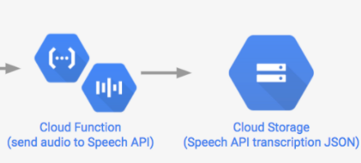

Module 2 workflow
STEP 11:-Extract the audio from a video and transcode it into a format the Speech API accepts.(FLAC file).
STEP 2:-Send the FLAC file to the Speech API and upload transcriptions to Cloud Storage.
STEP 3:-make a request to Cloud Speech with the client.
STEP 4:-Once processed, the API will return a response.
jjj
This is a translated text

Slide 27
Implementation and coding :-
MODULE 1:
SPLASH ACTIVITY:
package com.appcodewithprachi.speech2isl;
import android.app.Activity;
import android.content.Intent;
import android.os.Bundle;
import android.os.Handler;
public class SplashScreenLogo extends Activity {
Handler handler;
@Override
protected void onCreate(Bundle savedInstanceState) {
super.onCreate(savedInstanceState);
setContentView(R.layout.splash_screen_logo);
handler=new Handler();
handler.postDelayed(new Runnable() {
@Override
public void run() {
Intent intent=new Intent(SplashScreenLogo.this, LoginActivity.class);
startActivity(intent);
finish();
}
},3000);
}
}
<?xml version="1.0" encoding="utf-8"?>
<androidx.constraintlayout.widget.ConstraintLayout xmlns:android="http://schemas.android.com/apk/res/android"
xmlns:app="http://schemas.android.com/apk/res-auto"
xmlns:tools="http://schemas.android.com/tools"
android:layout_width="match_parent"
android:layout_height="match_parent"
android:background="#CF4A72"
tools:context=".SplashScreenLogo">
<TextView
android:id="@+id/textView"
android:layout_width="wrap_content"
android:layout_height="wrap_content"
android:layout_marginBottom="308dp"
android:backgroundTint="?android:attr/colorFocusedHighlight"
android:fontFamily="@font/dancing_script"
android:text="Recognize Everything Freely"
android:textColor="@color/white"

Slide 28
android:textSize="25sp"
android:textStyle="bold|italic"
app:layout_constraintBottom_toBottomOf="parent"
app:layout_constraintEnd_toEndOf="parent"
app:layout_constraintStart_toStartOf="parent" />
<ImageView
android:id="@+id/imageView3"
android:layout_width="263dp"
android:layout_height="223dp"
android:src="@drawable/logoisl"
app:layout_constraintBottom_toTopOf="@+id/textView"
app:layout_constraintEnd_toEndOf="parent"
app:layout_constraintHorizontal_bias="0.497"
app:layout_constraintStart_toStartOf="parent"
app:layout_constraintTop_toTopOf="parent"
app:layout_constraintVertical_bias="0.908" />
</androidx.constraintlayout.widget.ConstraintLayout>

Slide 29
lOGIN ACTIVITY:
package com.appcodewithprachi.speech2isl;
import android.content.Intent;
import android.content.SharedPreferences;
import android.os.Bundle;
import android.view.View;
import android.widget.Button;
import android.widget.EditText;
import androidx.appcompat.app.AppCompatActivity;
public class LoginActivity extends AppCompatActivity {
Button login;
EditText et;
SharedPreferences sp;
@Override
protected void onCreate(Bundle savedInstanceState) {
super.onCreate(savedInstanceState);
setContentView(R.layout.activity_login);
login = findViewById(R.id.submit);
et = findViewById(R.id.name);
login = (Button) findViewById(R.id.submit);
sp = getSharedPreferences("login",MODE_PRIVATE);
if(sp.getBoolean("logged",false)){
goToTabbedActivity();
}
login.setOnClickListener(new View.OnClickListener() {
@Override
public void onClick(View v) {
goToTabbedActivity();
sp.edit().putBoolean("logged",true).apply();
}
});
}
public void goToTabbedActivity(){
Intent i = new Intent(this,TabbedActivity.class);
startActivity(i);
finish();
}
}

Slide 30
<?xml version="1.0" encoding="utf-8"?>
<androidx.constraintlayout.widget.ConstraintLayout xmlns:android="http://schemas.android.com/apk/res/android"
xmlns:app="http://schemas.android.com/apk/res-auto"
xmlns:tools="http://schemas.android.com/tools"
android:layout_width="match_parent"
android:layout_height="match_parent"
android:background="#E75480"
tools:context=".LoginActivity">
<TextView
android:id="@+id/textView"
android:layout_width="337dp"
android:layout_height="166dp"
android:layout_marginTop="36dp"
android:background="#69263A"
android:fontFamily="@font/architects_daughter"
android:paddingLeft="20dp"
android:paddingTop="10dp"
android:text="@string/text_view"
android:textColor="?android:attr/windowBackground"
android:textSize="30sp"
app:layout_constraintEnd_toEndOf="parent"
app:layout_constraintStart_toStartOf="parent"
app:layout_constraintTop_toTopOf="parent" />
<EditText
android:id="@+id/name"
android:layout_width="350dp"
android:layout_height="55dp"
android:background="#69263A"
android:textColorHint="@color/white"
android:layout_centerHorizontal="true"
android:layout_marginHorizontal="10dp"
android:layout_marginBottom="76dp"
android:autofillHints="username"
android:fontFamily="@font/architects_daughter"
android:hint="Username"
android:inputType="textPersonName"
android:paddingStart="50dp"
android:paddingLeft="30dp"
android:textColor="@color/colorPrimaryDark"
app:layout_constraintBottom_toTopOf="@+id/email_id"
app:layout_constraintEnd_toEndOf="parent"
app:layout_constraintHorizontal_bias="0.500"
app:layout_constraintStart_toStartOf="parent"

Slide 31
tools:ignore="HardcodedText,MissingConstraints" />
<EditText
android:id="@+id/email_id"
android:layout_width="350dp"
android:layout_height="55dp"
android:background="#69263A"
android:layout_below="@+id/name"
android:layout_centerHorizontal="true"
android:textColorHint="@color/white"
android:layout_marginHorizontal="10dp"
android:layout_marginBottom="68dp"
android:autofillHints="Email Id"
android:fontFamily="@font/architects_daughter"
android:hint="Email Id"
android:inputType="textEmailAddress"
android:paddingStart="50dp"
android:paddingLeft="30dp"
android:textColor="@color/colorPrimaryDark"
app:layout_constraintBottom_toTopOf="@+id/password"
app:layout_constraintEnd_toEndOf="parent"
app:layout_constraintHorizontal_bias="0.500"
app:layout_constraintStart_toStartOf="parent"
tools:ignore="HardcodedText,MissingConstraints" />
<EditText
android:id="@+id/password"
android:layout_width="350dp"
android:layout_height="55dp"
android:layout_below="@+id/email_id"
android:background="#69263A"
android:layout_centerHorizontal="true"
android:textColorHint="@color/white"
android:layout_marginHorizontal="10dp"
android:layout_marginBottom="156dp"
android:autofillHints="Password"
android:fontFamily="@font/architects_daughter"
android:hint="Password"
android:inputType="textPassword"
android:paddingStart="50dp"
android:paddingLeft="30dp"
android:textColor="@color/colorPrimaryDark"
app:layout_constraintBottom_toBottomOf="parent"
app:layout_constraintEnd_toEndOf="parent"
app:layout_constraintHorizontal_bias="0.500"
app:layout_constraintStart_toStartOf="parent"
tools:ignore="HardcodedText" />

Slide 32
<Button
android:id="@+id/submit"
android:layout_width="wrap_content"
android:layout_height="wrap_content"
android:layout_below="@+id/password"
android:fontFamily="@font/architects_daughter"
android:text="@string/submit"
android:textColor="@android:color/white"
app:layout_constraintBottom_toBottomOf="parent"
app:layout_constraintEnd_toEndOf="parent"
app:layout_constraintHorizontal_bias="0.500"
app:layout_constraintStart_toStartOf="parent"
app:layout_constraintTop_toBottomOf="@+id/password"
android:background="#69263A"
app:layout_constraintVertical_bias="0.406" />
<androidx.constraintlayout.widget.Barrier
android:id="@+id/barrier"
android:layout_width="wrap_content"
android:layout_height="wrap_content"
app:barrierDirection="top" />
<ImageView
android:id="@+id/user_icon"
android:layout_width="40dp"
android:layout_height="55dp"
android:layout_marginStart="28dp"
android:layout_marginLeft="28dp"
android:paddingLeft="10dp"
app:layout_constraintBottom_toTopOf="@+id/email_id"
app:layout_constraintStart_toStartOf="parent"
app:layout_constraintTop_toTopOf="@+id/name"
app:layout_constraintVertical_bias="0.0"
app:srcCompat="@drawable/username_icon" />
<ImageView
android:id="@+id/email_icon"
android:layout_width="40dp"
android:layout_height="55dp"
android:layout_marginStart="28dp"
android:layout_marginLeft="28dp"
android:paddingLeft="10dp"
app:layout_constraintBottom_toTopOf="@+id/password"
app:layout_constraintStart_toStartOf="parent"
app:layout_constraintTop_toTopOf="@+id/email_id"
app:layout_constraintVertical_bias="0.0"

Slide 33
app:srcCompat="@drawable/email_id_icon" />
<ImageView
android:id="@+id/password_icon"
android:layout_width="40dp"
android:layout_height="55dp"
android:layout_marginStart="28dp"
android:layout_marginLeft="28dp"
android:paddingLeft="10dp"
app:layout_constraintBottom_toTopOf="@+id/submit"
app:layout_constraintStart_toStartOf="parent"
app:layout_constraintTop_toTopOf="@+id/password"
app:layout_constraintVertical_bias="0.0"
app:srcCompat="@drawable/password_icon" />
</androidx.constraintlayout.widget.ConstraintLayout>
TABBED ACTIVITY:
package com.appcodewithprachi.speech2isl;
import androidx.appcompat.app.AppCompatActivity;
import androidx.viewpager.widget.ViewPager;
import android.os.Bundle;
import com.google.android.material.tabs.TabItem;
import com.google.android.material.tabs.TabLayout;
public class TabbedActivity extends AppCompatActivity {
TabLayout tabLayout;
TabItem tabItem1,tabItem2, tabItem3;
ViewPager viewPager;
PageAdapter pageAdapter;
@Override
protected void onCreate(Bundle savedInstanceState) {
super.onCreate(savedInstanceState);
setContentView(R.layout.activity_tabbed);
TabLayout tabLayout = (TabLayout) findViewById(R.id.tablayout1);
TabItem tabItem1 = (TabItem) findViewById(R.id.tab1);
TabItem tabItem2 = (TabItem) findViewById(R.id.tab2);

Slide 34
TabItem tabItem3 = (TabItem) findViewById(R.id.tab3);
final ViewPager viewPager = (ViewPager) findViewById(R.id.vpager);
pageAdapter=new PageAdapter(getSupportFragmentManager(),tabLayout.getTabCount());
viewPager.setAdapter(pageAdapter);
tabLayout.setOnTabSelectedListener(new TabLayout.OnTabSelectedListener() {
@Override
public void onTabSelected(TabLayout.Tab tab) {
viewPager.setCurrentItem(tab.getPosition());
if(tab.getPosition()==0 || tab.getPosition()==1 || tab.getPosition()==2)
pageAdapter.notifyDataSetChanged();
}
@Override
public void onTabUnselected(TabLayout.Tab tab) {
}
@Override
public void onTabReselected(TabLayout.Tab tab) {
}
});
viewPager.addOnPageChangeListener(new TabLayout.TabLayoutOnPageChangeListener(tabLayout));
//listen for scroll or page change
}
}
PAGEADAPTER ACTIVITY JAVA
package com.appcodewithprachi.speech2isl;
import androidx.annotation.NonNull;
import androidx.fragment.app.Fragment;
import androidx.fragment.app.FragmentManager;
import androidx.fragment.app.FragmentPagerAdapter;
public class PageAdapter extends FragmentPagerAdapter
{
int tabcount;
public PageAdapter(@NonNull FragmentManager fm, int behavior) {
super(fm, behavior);
tabcount=behavior;
}

Slide 35
@NonNull
@Override
public Fragment getItem(int position)
{
switch (position)
{
case 0 : return new QuotesFragment();
case 1 : return new DirectionFragment();
case 2 : return new ConverterrFragment();
default: return null;
}
}
@Override
public int getCount() {
return tabcount;
}
}
WELCOME ACTIVITY:
package com.appcodewithprachi.speech2isl;
import android.os.Bundle;
import androidx.fragment.app.Fragment;
import android.view.LayoutInflater;
import android.view.View;
import android.view.ViewGroup;
/**
* A simple {@link Fragment} subclass.
* Use the {@link QuotesFragment#newInstance} factory method to
* create an instance of this fragment.
*/
public class QuotesFragment extends Fragment {
// TODO: Rename parameter arguments, choose names that match
// the fragment initialization parameters, e.g. ARG_ITEM_NUMBER
private static final String ARG_PARAM1 = "param1";
private static final String ARG_PARAM2 = "param2";

Slide 36
// TODO: Rename and change types of parameters
private String mParam1;
private String mParam2;
public QuotesFragment() {
// Required empty public constructor
}
/**
* Use this factory method to create a new instance of
* this fragment using the provided parameters.
*
* @param param1 Parameter 1.
* @param param2 Parameter 2.
* @return A new instance of fragment QuotesFragment.
*/
// TODO: Rename and change types and number of parameters
public static QuotesFragment newInstance(String param1, String param2) {
QuotesFragment fragment = new QuotesFragment();
Bundle args = new Bundle();
args.putString(ARG_PARAM1, param1);
args.putString(ARG_PARAM2, param2);
fragment.setArguments(args);
return fragment;
}
@Override
public void onCreate(Bundle savedInstanceState) {
super.onCreate(savedInstanceState);
if (getArguments() != null) {
mParam1 = getArguments().getString(ARG_PARAM1);
mParam2 = getArguments().getString(ARG_PARAM2);
}
}
@Override
public View onCreateView(LayoutInflater inflater, ViewGroup container,
Bundle savedInstanceState) {
// Inflate the layout for this fragment
return inflater.inflate(R.layout.fragment_quotes, container, false);
}
}

Slide 37
<?xml version="1.0" encoding="utf-8"?>
<androidx.constraintlayout.widget.ConstraintLayout xmlns:android="http://schemas.android.com/apk/res/android"
xmlns:app="http://schemas.android.com/apk/res-auto"
xmlns:tools="http://schemas.android.com/tools"
android:id="@+id/constraintLayout"
android:layout_width="match_parent"
android:layout_height="match_parent"
android:background="#CF4A72"
tools:context=".QuotesFragment">
<!-- TODO: Update blank fragment layout -->
<TextView
android:id="@+id/quote"
android:layout_width="260dp"
android:layout_height="wrap_content"
android:gravity="center"
android:layout_marginBottom="152dp"
android:fontFamily="@font/architects_daughter"
android:text="Without your involvement you can’t succeed. With your involvement you can’t fail.
-By APJ Abdul Kalam"
android:textColor="@color/white"
android:textSize="25sp"
app:layout_constraintBottom_toBottomOf="parent"
app:layout_constraintEnd_toEndOf="parent"
app:layout_constraintHorizontal_bias="0.528"
app:layout_constraintStart_toStartOf="parent" />
<ImageView
android:id="@+id/education_quote"
android:layout_width="292dp"
android:layout_height="276dp"
android:layout_marginBottom="24dp"
android:src="@drawable/education"
app:layout_constraintBottom_toTopOf="@+id/quote"
app:layout_constraintEnd_toEndOf="parent"
app:layout_constraintHorizontal_bias="0.554"
app:layout_constraintStart_toStartOf="parent"
app:layout_constraintTop_toTopOf="parent"
app:layout_constraintVertical_bias="1.0" />
</androidx.constraintlayout.widget.ConstraintLayout>

Slide 38
DIRECTION FRAGMENT:
package com.appcodewithprachi.speech2isl;
import android.content.Intent;
import android.os.Bundle;
import android.view.LayoutInflater;
import android.view.View;
import android.view.ViewGroup;
import android.widget.ImageButton;
import androidx.fragment.app.Fragment;
// Import permission files.
/**
* A simple {@link Fragment} subclass.
* Use the {@link DirectionFragment#newInstance} factory method to
* create an instance of this fragment.
*/
public class DirectionFragment extends Fragment {
ImageButton button;
// TODO: Rename parameter arguments, choose names that match
// the fragment initialization parameters, e.g. ARG_ITEM_NUMBER
private static final String ARG_PARAM1 = "param1";
private static final String ARG_PARAM2 = "param2";
// TODO: Rename and change types of parameters
private String mParam1;
private String mParam2;
public DirectionFragment() {
// Required empty public constructor
}
/**
* Use this factory method to create a new instance of
* this fragment using the provided parameters.
*
* @param param1 Parameter 1.
* @param param2 Parameter 2.
* @return A new instance of fragment DirectionFragment.
*/
// TODO: Rename and change types and number of parameters
public static DirectionFragment newInstance(String param1, String param2) {
DirectionFragment fragment = new DirectionFragment();
Bundle args = new Bundle();

Slide 39
args.putString(ARG_PARAM1, param1);
args.putString(ARG_PARAM2, param2);
fragment.setArguments(args);
return fragment;
}
@Override
public void onCreate(Bundle savedInstanceState) {
super.onCreate(savedInstanceState);
if (getArguments() != null) {
mParam1 = getArguments().getString(ARG_PARAM1);
mParam2 = getArguments().getString(ARG_PARAM2);
}
}
@Override
public View onCreateView(LayoutInflater inflater, ViewGroup container,
Bundle savedInstanceState) {
// Inflate the layout for this fragment
View v = inflater.inflate(R.layout.fragment_direction, container, false);
button = v.findViewById(R.id.imageButtongotonavbar);
button.setOnClickListener(new View.OnClickListener() {
@Override
public void onClick(View v) {
startActivity(new Intent(getActivity(),NavigationActivity.class));
}
});
return v;
}
}
<?xml version="1.0" encoding="utf-8"?>
<androidx.constraintlayout.widget.ConstraintLayout xmlns:android="http://schemas.android.com/apk/res/android"
xmlns:app="http://schemas.android.com/apk/res-auto"
xmlns:tools="http://schemas.android.com/tools"
android:id="@+id/constraintLayout"
android:layout_width="match_parent"
android:layout_height="match_parent"
android:background="#CF4A72"
>
<TextView
android:id="@+id/section_label"
android:layout_width="wrap_content"
android:layout_height="wrap_content"
android:layout_marginStart="@dimen/activity_horizontal_margin"
android:layout_marginTop="@dimen/activity_vertical_margin"
android:layout_marginEnd="@dimen/activity_horizontal_margin"
android:layout_marginBottom="@dimen/activity_vertical_margin"
app:layout_constraintLeft_toLeftOf="parent"
app:layout_constraintTop_toTopOf="@+id/constraintLayout"
tools:layout_constraintLeft_creator="1"
tools:layout_constraintTop_creator="1" />

Slide 40
<TextView
android:id="@+id/split_screen"
android:layout_width="340dp"
android:layout_height="wrap_content"
android:layout_marginTop="16dp"
android:background="#FF759F"
android:fontFamily="@font/architects_daughter"
android:text="@string/how_to_use_split_screen_mode_on_an_android_device"
android:textColor="@color/white"
android:textSize="20sp"
app:layout_constraintEnd_toEndOf="parent"
app:layout_constraintHorizontal_bias="0.42"
app:layout_constraintStart_toStartOf="parent"
app:layout_constraintTop_toTopOf="parent" />
<TextView
android:id="@+id/step1"
android:layout_width="340dp"
android:layout_height="wrap_content"
android:layout_marginTop="12dp"
android:background="#54E864"
android:fontFamily="@font/architects_daughter"
android:text="@string/step1"
android:textColor="@color/white"
app:layout_constraintEnd_toEndOf="parent"
app:layout_constraintHorizontal_bias="0.42"
app:layout_constraintStart_toStartOf="parent"
app:layout_constraintTop_toBottomOf="@+id/split_screen" />
<TextView
android:id="@+id/step2"
android:layout_width="340dp"
android:layout_height="wrap_content"
android:layout_marginTop="84dp"
android:background="#54E864"
android:fontFamily="@font/architects_daughter"
android:text="@string/step3"
android:textColor="@color/white"
app:layout_constraintEnd_toEndOf="parent"
app:layout_constraintHorizontal_bias="0.42"
app:layout_constraintStart_toStartOf="parent"
app:layout_constraintTop_toTopOf="@+id/step1" />
<TextView
android:id="@+id/step4"
android:layout_width="340dp"
android:layout_height="wrap_content"
android:layout_marginTop="8dp"
android:background="#54E864"
android:fontFamily="@font/architects_daughter"
android:text="@string/step4"
android:textColor="@color/white"
app:layout_constraintEnd_toEndOf="parent"

Slide 41
app:layout_constraintHorizontal_bias="0.422"
app:layout_constraintStart_toStartOf="parent"
app:layout_constraintTop_toBottomOf="@+id/step2" />
<TextView
android:id="@+id/step5"
android:layout_width="340dp"
android:layout_height="wrap_content"
android:layout_marginTop="8dp"
android:background="#54E864"
android:fontFamily="@font/architects_daughter"
android:text="@string/step55"
android:textColor="@color/white"
app:layout_constraintEnd_toEndOf="parent"
app:layout_constraintHorizontal_bias="0.422"
app:layout_constraintStart_toStartOf="parent"
app:layout_constraintTop_toBottomOf="@+id/step4" />
<TextView
android:id="@+id/step6"
android:layout_width="340dp"
android:layout_height="wrap_content"
android:layout_marginTop="8dp"
android:background="#54E864"
android:fontFamily="@font/architects_daughter"
NAVIGATION ACTIVITY
package com.appcodewithprachi.speech2isl;
import android.os.Bundle;
import android.view.Menu;
import androidx.appcompat.app.AppCompatActivity;
import androidx.appcompat.widget.Toolbar;
import androidx.drawerlayout.widget.DrawerLayout;
import androidx.navigation.NavController;
import androidx.navigation.Navigation;
import androidx.navigation.ui.AppBarConfiguration;
import androidx.navigation.ui.NavigationUI;
import com.google.android.gms.auth.api.signin.GoogleSignInClient;
import com.google.android.material.navigation.NavigationView;
public class NavigationActivity extends AppCompatActivity {
private AppBarConfiguration mAppBarConfiguration;
GoogleSignInClient mGoogleSignInClient;

Slide 42
@Override
protected void onCreate(Bundle savedInstanceState) {
super.onCreate(savedInstanceState);
setContentView(R.layout.activity_navigation);
Toolbar toolbar = findViewById(R.id.toolbar);
setSupportActionBar(toolbar);
DrawerLayout drawer = findViewById(R.id.drawer_layout);
NavigationView navigationView = findViewById(R.id.nav_view);
// Passing each menu ID as a set of Ids because each
// menu should be considered as top level destinations.
mAppBarConfiguration = new AppBarConfiguration.Builder(
R.id.nav_home, R.id.nav_books, R.id.nav_makenotes)
.setDrawerLayout(drawer)
.build();
NavController navController = Navigation.findNavController(this, R.id.nav_host_fragment);
NavigationUI.setupActionBarWithNavController(this, navController, mAppBarConfiguration);
NavigationUI.setupWithNavController(navigationView, navController);
}
//public void OpenSettings(View view) {
// Intent intent = new Intent(this,SettingsActivity.class);
//startActivity(intent);
//}

Slide 43
@Override
public boolean onCreateOptionsMenu(Menu menu) {
// Inflate the menu; this adds items to the action bar if it is present.
getMenuInflater().inflate(R.menu.navigation, menu);
return true;
}
@Override
public boolean onSupportNavigateUp() {
NavController navController = Navigation.findNavController(this, R.id.nav_host_fragment);
return NavigationUI.navigateUp(navController, mAppBarConfiguration)
|| super.onSupportNavigateUp();
}
}
<?xml version="1.0" encoding="utf-8"?>
<androidx.drawerlayout.widget.DrawerLayout xmlns:android="http://schemas.android.com/apk/res/android"
xmlns:app="http://schemas.android.com/apk/res-auto"
xmlns:tools="http://schemas.android.com/tools"
android:id="@+id/drawer_layout"
android:layout_width="match_parent"
android:layout_height="match_parent"
android:fitsSystemWindows="true"
tools:openDrawer="start">
<include
layout="@layout/app_bar_main"
android:layout_width="match_parent"
android:layout_height="match_parent" />
<com.google.android.material.navigation.NavigationView
android:id="@+id/nav_view"
android:layout_width="wrap_content"
android:layout_height="match_parent"
android:layout_gravity="start"
android:fitsSystemWindows="true"
app:headerLayout="@layout/nav_header_main"
app:menu="@menu/activity_main_drawer" />
</androidx.drawerlayout.widget.DrawerLayout>

Slide 44
HOME FRAGMENT JAVA:
package com.appcodewithprachi.speech2isl.ui.books;
import android.os.Bundle;
import android.view.LayoutInflater;
import android.view.View;
import android.view.ViewGroup;
import android.widget.TextView;
import androidx.annotation.NonNull;
import androidx.annotation.Nullable;
import androidx.fragment.app.Fragment;
import androidx.lifecycle.Observer;
import androidx.lifecycle.ViewModelProviders;
import com.appcodewithprachi.speech2isl.R;
public class BooksFragment extends Fragment {
private BooksViewModel booksViewModel;
public View onCreateView(@NonNull LayoutInflater inflater,
ViewGroup container, Bundle savedInstanceState) {
booksViewModel =
ViewModelProviders.of(this).get(BooksViewModel.class);
View root = inflater.inflate(R.layout.fragment_books, container, false);
final TextView textView = root.findViewById(R.id.text_books);
booksViewModel.getText().observe(getViewLifecycleOwner(), new Observer<String>() {
@Override
public void onChanged(@Nullable String s) {
textView.setText(s);
}
});
return root;
}
}

Slide 45
<?xml version="1.0" encoding="utf-8"?>
<androidx.constraintlayout.widget.ConstraintLayout xmlns:android="http://schemas.android.com/apk/res/android"
xmlns:app="http://schemas.android.com/apk/res-auto"
xmlns:tools="http://schemas.android.com/tools"
android:layout_width="match_parent"
android:layout_height="match_parent"
android:background="#F55887"
tools:context=".ui.books.BooksFragment">
<TextView
android:id="@+id/text_books"
android:layout_width="wrap_content"
android:layout_height="wrap_content"
android:layout_marginStart="8dp"
android:layout_marginTop="8dp"
android:layout_marginEnd="8dp"
android:text="Books"
android:textAlignment="center"
android:textSize="20sp"
app:layout_constraintBottom_toBottomOf="parent"
app:layout_constraintEnd_toEndOf="parent"
app:layout_constraintHorizontal_bias="0.498"
app:layout_constraintStart_toStartOf="parent"
app:layout_constraintTop_toTopOf="parent"
app:layout_constraintVertical_bias="0.097" />
<ImageView
android:id="@+id/imagebook"
android:layout_width="wrap_content"
android:layout_height="wrap_content"
android:layout_marginTop="32dp"
android:src="@drawable/bookimages"
app:layout_constraintEnd_toEndOf="parent"
app:layout_constraintHorizontal_bias="0.496"
app:layout_constraintStart_toStartOf="parent"
app:layout_constraintTop_toBottomOf="@+id/text_books" />
<TextView
android:id="@+id/textView3"
android:layout_width="wrap_content"
android:layout_height="wrap_content"
android:text="Nothing to show here right now!"
app:layout_constraintBottom_toBottomOf="parent"
app:layout_constraintEnd_toEndOf="parent"
app:layout_constraintHorizontal_bias="0.498"
app:layout_constraintStart_toStartOf="parent"
app:layout_constraintTop_toBottomOf="@+id/imagebook"
app:layout_constraintVertical_bias="0.234" />
</androidx.constraintlayout.widget.ConstraintLayout>

Slide 46
HOME FRAGMENT JAVA
package com.appcodewithprachi.speech2isl.ui.home;
import android.os.Bundle;
import android.view.LayoutInflater;
import android.view.View;
import android.view.ViewGroup;
import android.widget.TextView;
import androidx.annotation.NonNull;
import androidx.annotation.Nullable;
import androidx.fragment.app.Fragment;
import androidx.lifecycle.Observer;
import androidx.lifecycle.ViewModelProviders;
import com.appcodewithprachi.speech2isl.R;
public class HomeFragment extends Fragment {
private HomeViewModel homeViewModel;
public View onCreateView(@NonNull LayoutInflater inflater,
ViewGroup container, Bundle savedInstanceState) {
homeViewModel =
ViewModelProviders.of(this).get(HomeViewModel.class);
View root = inflater.inflate(R.layout.fragment_home, container, false);
final TextView textView = root.findViewById(R.id.text_home);
homeViewModel.getText().observe(getViewLifecycleOwner(), new Observer<String>() {
@Override
public void onChanged(@Nullable String s) {
textView.setText(s);
}
});
return root;
}
}

Slide 47
<?xml version="1.0" encoding="utf-8"?>
<androidx.constraintlayout.widget.ConstraintLayout xmlns:android="http://schemas.android.com/apk/res/android"
xmlns:app="http://schemas.android.com/apk/res-auto"
xmlns:tools="http://schemas.android.com/tools"
android:layout_width="match_parent"
android:layout_height="match_parent"
android:background="#F55887"
tools:context=".ui.home.HomeFragment">
<TextView
android:id="@+id/text_home"
android:layout_width="match_parent"
android:layout_height="wrap_content"
android:layout_marginStart="8dp"
android:layout_marginTop="8dp"
android:layout_marginEnd="8dp"
android:textAlignment="center"
android:textSize="20sp"
android:text="Home"
app:layout_constraintBottom_toBottomOf="parent"
app:layout_constraintEnd_toEndOf="parent"
app:layout_constraintStart_toStartOf="parent"
app:layout_constraintTop_toTopOf="parent" />
</androidx.constraintlayout.widget.ConstraintLayout>
MAKENOTES FRAGMENT
package com.appcodewithprachi.speech2isl.ui.makenotes;
import android.os.Bundle;
import android.view.LayoutInflater;
import android.view.View;
import android.view.ViewGroup;
import android.widget.TextView;
import androidx.annotation.NonNull;
import androidx.annotation.Nullable;
import androidx.fragment.app.Fragment;
import androidx.lifecycle.Observer;
import androidx.lifecycle.ViewModelProviders;
<?xml version="1.0" encoding="utf-8"?>
<androidx.constraintlayout.widget.ConstraintLayout xmlns:android="http://schemas.android.com/apk/res/android"
xmlns:app="http://schemas.android.com/apk/res-auto"
xmlns:tools="http://schemas.android.com/tools"
android:layout_width="match_parent"
android:layout_height="match_parent"
android:background="#F55887"
tools:context=".ui.home.HomeFragment">
<TextView
android:id="@+id/text_home"
android:layout_width="match_parent"
android:layout_height="wrap_content"
android:layout_marginStart="8dp"
android:layout_marginTop="8dp"
android:layout_marginEnd="8dp"
android:textAlignment="center"
android:textSize="20sp"
android:text="Home"
app:layout_constraintBottom_toBottomOf="parent"
app:layout_constraintEnd_toEndOf="parent"
app:layout_constraintStart_toStartOf="parent"
app:layout_constraintTop_toTopOf="parent" />
</androidx.constraintlayout.widget.ConstraintLayout>
MAKENOTES FRAGMENT
package com.appcodewithprachi.speech2isl.ui.makenotes;
import android.os.Bundle;
import android.view.LayoutInflater;
import android.view.View;
import android.view.ViewGroup;
import android.widget.TextView;
import androidx.annotation.NonNull;
import androidx.annotation.Nullable;
import androidx.fragment.app.Fragment;
import androidx.lifecycle.Observer;
import androidx.lifecycle.ViewModelProviders;

Slide 48
import com.appcodewithprachi.speech2isl.R;
public class MakenotesFragment extends Fragment {
private MakenotesViewModel makenotesViewModel;
public View onCreateView(@NonNull LayoutInflater inflater,
ViewGroup container, Bundle savedInstanceState) {
makenotesViewModel =
ViewModelProviders.of(this).get(MakenotesViewModel.class);
View root = inflater.inflate(R.layout.fragment_makenotes, container, false);
final TextView textView = root.findViewById(R.id.text_makenotes);
makenotesViewModel.getText().observe(getViewLifecycleOwner(), new Observer<String>() {
@Override
public void onChanged(@Nullable String s) {
textView.setText(s);
}
});
return root;
}
}
<?xml version="1.0" encoding="utf-8"?>
<androidx.constraintlayout.widget.ConstraintLayout xmlns:android="http://schemas.android.com/apk/res/android"
xmlns:app="http://schemas.android.com/apk/res-auto"
xmlns:tools="http://schemas.android.com/tools"
android:layout_width="match_parent"
android:layout_height="match_parent"
android:background="#F55887"
tools:context=".ui.makenotes.MakenotesFragment">
<TextView
android:id="@+id/text_makenotes"
android:layout_width="wrap_content"
android:layout_height="wrap_content"
android:layout_marginStart="8dp"
android:layout_marginTop="8dp"
android:layout_marginEnd="8dp"
android:text="Make Notes"
android:textAlignment="center"
android:textSize="20sp"
app:layout_constraintBottom_toBottomOf="parent"
app:layout_constraintEnd_toEndOf="parent"
app:layout_constraintStart_toStartOf="parent"
app:layout_constraintTop_toTopOf="parent"
app:layout_constraintVertical_bias="0.068" />

Slide 49
<ImageView
android:id="@+id/imageNotes"
android:layout_width="318dp"
android:layout_height="230dp"
android:layout_marginTop="32dp"
android:src="@drawable/notesimages"
app:layout_constraintEnd_toEndOf="parent"
app:layout_constraintHorizontal_bias="0.494"
app:layout_constraintStart_toStartOf="parent"
app:layout_constraintTop_toBottomOf="@+id/text_makenotes" />
<TextView
android:id="@+id/textView4"
android:layout_width="wrap_content"
android:layout_height="wrap_content"
android:text="Nothing to show here right now...... "
app:layout_constraintBottom_toBottomOf="parent"
app:layout_constraintEnd_toEndOf="parent"
app:layout_constraintHorizontal_bias="0.498"
app:layout_constraintStart_toStartOf="parent"
app:layout_constraintTop_toBottomOf="@+id/imageNotes"
app:layout_constraintVertical_bias="0.233" />
</androidx.constraintlayout.widget.ConstraintLayout>
Nav_header_main.xml
<?xml version="1.0" encoding="utf-8"?>
<androidx.constraintlayout.widget.ConstraintLayout xmlns:android="http://schemas.android.com/apk/res/android"
xmlns:app="http://schemas.android.com/apk/res-auto"
xmlns:tools="http://schemas.android.com/tools"
android:layout_width="match_parent"
android:layout_height="@dimen/nav_header_height"
android:background="#199C28"
android:gravity="bottom"
android:orientation="vertical"
android:paddingLeft="@dimen/activity_horizontal_margin"
android:paddingTop="@dimen/activity_vertical_margin"
android:paddingRight="@dimen/activity_horizontal_margin"
android:paddingBottom="@dimen/activity_vertical_margin"
android:theme="@style/ThemeOverlay.AppCompat.Dark">

Slide 50
<TextView
android:layout_width="wrap_content"
android:layout_height="wrap_content"
android:layout_marginTop="8dp"
android:fontFamily="@font/architects_daughter"
android:paddingTop="@dimen/nav_header_vertical_spacing"
android:text="S2ISL"
android:textAppearance="@style/TextAppearance.AppCompat.Body1"
app:layout_constraintEnd_toEndOf="parent"
app:layout_constraintHorizontal_bias="0.0"
app:layout_constraintStart_toStartOf="parent"
app:layout_constraintTop_toBottomOf="@+id/imageView" />
<ImageView
android:id="@+id/imageView"
android:layout_width="98dp"
android:layout_height="73dp"
android:layout_marginTop="24dp"
android:background="@color/white"
app:layout_constraintEnd_toEndOf="parent"
app:layout_constraintHorizontal_bias="0.0"
app:layout_constraintStart_toStartOf="parent"
app:layout_constraintTop_toTopOf="parent"
app:srcCompat="@drawable/logoisl" />
</androidx.constraintlayout.widget.ConstraintLayout>
App_bar_mai
<?xml version="1.0" encoding="utf-8"?>
<androidx.coordinatorlayout.widget.CoordinatorLayout xmlns:android="http://schemas.android.com/apk/res/android"
xmlns:app="http://schemas.android.com/apk/res-auto"
xmlns:tools="http://schemas.android.com/tools"
android:layout_width="match_parent"
android:layout_height="match_parent"
tools:context=".NavigationActivity">
<com.google.android.material.appbar.AppBarLayout
android:layout_width="match_parent"
android:layout_height="wrap_content"
android:theme="@style/AppTheme.AppBarOverlay">
<androidx.appcompat.widget.Toolbar
android:id="@+id/toolbar"
android:layout_width="match_parent"
android:layout_height="?attr/actionBarSize"
android:background="#199C28"
app:popupTheme="@style/AppTheme.PopupOverlay" />
</com.google.android.material.appbar.AppBarLayout>
<include layout="@layout/content_main" />
</androidx.coordinatorlayout.widget.CoordinatorLayout>

Slide 51
Activity_main_drawer
<?xml version="1.0" encoding="utf-8"?>
<menu xmlns:android="http://schemas.android.com/apk/res/android"
xmlns:tools="http://schemas.android.com/tools"
tools:showIn="navigation_view">
<group android:checkableBehavior="single">
<item
android:id="@+id/nav_home"
android:icon="@drawable/ic_baseline_home_24"
android:title="@string/menu_home" />
<item
android:id="@+id/nav_books"
android:icon="@drawable/ic_baseline_notes_24"
android:title="Books" />
<item
android:id="@+id/nav_makenotes"
android:icon="@drawable/ic_baseline_library_books_24"
android:title="Make Notes" />
</group>
</menu>
Navigation.xml
<?xml version="1.0" encoding="utf-8"?>
<menu xmlns:android="http://schemas.android.com/apk/res/android"
xmlns:app="http://schemas.android.com/apk/res-auto">
<item
android:id="@+id/action_profile"
android:orderInCategory="100"
android:title="Profile"
app:showAsAction="never" />
<item
android:id="@+id/action_settings"
android:orderInCategory="100"
android:title="@string/action_settings"
app:showAsAction="never" />
</menu>

Slide 52
MODULE 2
CONVERTER JAVA
package com.appcodewithprachi.speech2isl;
import android.content.Intent;
import android.net.Uri;
import android.os.Bundle;
import android.speech.RecognizerIntent;
import android.view.LayoutInflater;
import android.view.View;
import android.view.ViewGroup;
import android.widget.EditText;
import android.widget.ImageButton;
import android.widget.MediaController;
import android.widget.VideoView;
import androidx.annotation.Nullable;
import androidx.fragment.app.Fragment;
import java.util.ArrayList;
import static android.app.Activity.RESULT_OK;
public class ConverterrFragment extends Fragment {
//ImageButton speechButton;
EditText speechText;
private static final int RECOGNIZER_RESULT = 1;
// TODO: Rename parameter arguments, choose names that match
// the fragment initialization parameters, e.g. ARG_ITEM_NUMBER
private static final String ARG_PARAM1 = "param1";
private static final String ARG_PARAM2 = "param2";
// TODO: Rename and change types of parameters
private String mParam1;
private String mParam2;
public ConverterrFragment() {
// Required empty public constructor
}
/**
* Use this factory method to create a new instance of
* this fragment using the provided parameters.
*
* @param param1 Parameter 1.
* @param param2 Parameter 2.
* @return A new instance of fragment ConverterrFragment.
*/

Slide 53
public static ConverterrFragment newInstance(String param1, String param2) {
ConverterrFragment fragment = new ConverterrFragment();
Bundle args = new Bundle();
args.putString(ARG_PARAM1, param1);
args.putString(ARG_PARAM2, param2);
fragment.setArguments(args);
return fragment;
}
@Override
public void onCreate(Bundle savedInstanceState) {
super.onCreate(savedInstanceState);
if (getArguments() != null) {
mParam1 = getArguments().getString(ARG_PARAM1);
mParam2 = getArguments().getString(ARG_PARAM2);
}
}
//@Override
public View onCreateView(LayoutInflater inflater, ViewGroup container,
Bundle savedInstanceState) {
View root = inflater.inflate(R.layout.fragment_converterr, container, false);
final VideoView signlangvideo = root.findViewById(R.id.signlanguageview);
signlangvideo.setMediaController(new MediaController(getContext()));
}

Slide 54
Uri video = Uri.parse("android.resource://" + getContext().getPackageName() + "/" + R.raw.onetoninesignlangvideo);
signlangvideo.setVideoURI(video);
//signlangvideo.start();
// Inflate the layout for this fragment
ImageButton speechButton = (ImageButton) root.findViewById(R.id.imageButtonspeech);
EditText speechText = (EditText) root.findViewById(R.id.text);
speechButton.setOnClickListener(new View.OnClickListener() {
@Override
public void onClick(View view) {
Intent speechIntent = new Intent(RecognizerIntent.ACTION_RECOGNIZE_SPEECH);
speechIntent.putExtra(RecognizerIntent.EXTRA_LANGUAGE_MODEL, RecognizerIntent.LANGUAGE_MODEL_FREE_FORM);
speechIntent.putExtra(RecognizerIntent.EXTRA_PROMPT,"Speech to ISL");
startActivityForResult(speechIntent, RECOGNIZER_RESULT);
}
});
return root;
}
// from here the text will be transfered to a deep learning model which translate text to Indian sign language
public void onActivityResult(int requestCode, int resultCode, @Nullable Intent data) {
if (requestCode == RECOGNIZER_RESULT && resultCode == RESULT_OK) {
ArrayList<String> matches = data.getStringArrayListExtra(RecognizerIntent.EXTRA_RESULTS);
speechText.setText(matches.get(0).toString());
}
super.onActivityResult(requestCode, resultCode, data);
}

Slide 55
<?xml version="1.0" encoding="utf-8"?>
<androidx.constraintlayout.widget.ConstraintLayout xmlns:android="http://schemas.android.com/apk/res/android"
xmlns:app="http://schemas.android.com/apk/res-auto"
xmlns:tools="http://schemas.android.com/tools"
android:layout_width="match_parent"
android:layout_height="match_parent"
android:background="#CF4A72"
tools:context=".ConverterrFragment">
<!-- TODO: Update blank fragment layout -->
<TextView
android:id="@+id/textView2"
android:layout_width="wrap_content"
android:layout_height="wrap_content"
android:fontFamily="@font/architects_daughter"
android:text="Translator"
android:textColor="@color/white"
app:layout_constraintBottom_toBottomOf="parent"
app:layout_constraintEnd_toEndOf="parent"
app:layout_constraintStart_toStartOf="parent"
app:layout_constraintTop_toTopOf="parent"
app:layout_constraintVertical_bias="0.036" />
<EditText
android:id="@+id/text"
android:layout_width="wrap_content"
android:layout_height="wrap_content"
android:layout_marginTop="16dp"
android:fontFamily="@font/architects_daughter"
android:hint="Speech to Indian Sign Language Translation"
android:textColor="@color/white"
android:textColorHint="@color/white"
app:layout_constraintEnd_toEndOf="parent"
app:layout_constraintStart_toStartOf="parent"
app:layout_constraintTop_toBottomOf="@+id/imageButtonspeech" />
<VideoView
android:id="@+id/signlanguageview"
android:layout_width="355dp"
android:layout_height="364dp"
app:layout_constraintBottom_toBottomOf="parent"
app:layout_constraintEnd_toEndOf="parent"
app:layout_constraintStart_toStartOf="parent"
app:layout_constraintTop_toBottomOf="@+id/text" />

Slide 56
<ImageButton
android:id="@+id/imageButtonspeech"
android:layout_width="226dp"
android:layout_height="185dp"
android:layout_marginTop="52dp"
android:src="@drawable/imagemicrophone"
app:layout_constraintEnd_toEndOf="parent"
app:layout_constraintHorizontal_bias="0.497"
app:layout_constraintStart_toStartOf="parent"
app:layout_constraintTop_toTopOf="parent" />
</androidx.constraintlayout.widget.ConstraintLayout>

Slide 57
MODULE 3
import os, sys
from keras.models import Model
from keras.layers import Input, LSTM, GRU, Dense, Embedding
from keras.preprocessing.text import Tokenizer
from keras.preprocessing.sequence import pad_sequences
from keras.utils import to_categorical
import numpy as np
import matplotlib.pyplot as plt
BATCH_SIZE = 64
EPOCHS = 20
LSTM_NODES =256
NUM_SENTENCES = 50
MAX_SENTENCE_LENGTH = 10
MAX_NUM_WORDS = 1000
EMBEDDING_SIZE = 100

Slide 58
DATA PREPARATION & PREPROCESSING
input_sentences = []
output_sentences = []
output_sentences_inputs = []
count = 0
for line in open(r'/content/numerical.txt',encoding='latin-1'):
count += 1
if count > NUM_SENTENCES:
break
if '\n' not in line:
continue
input_sentence, output = line.rstrip().split('\n')
output_sentence = output + ' <eos>'
output_sentence_input = '<sos> ' + output
input_sentences.append(input_sentence)
output_sentences.append(output_sentence)
output_sentences_inputs.append(output_sentence_input)
print("num samples input:", len(input_sentences))
print("num samples output:", len(output_sentences))
print("num samples output input:", len(output_sentences_inputs))

Slide 59
TOKENIZATION & PADDING
output_tokenizer = Tokenizer(num_words=MAX_NUM_WORDS, filters='')
output_tokenizer.fit_on_texts(output_sentences + output_sentences_inputs)
output_integer_seq = output_tokenizer.texts_to_sequences(output_sentences)
output_input_integer_seq = output_tokenizer.texts_to_sequences(output_sentences_inputs)
word2idx_outputs = output_tokenizer.word_index
print('Total unique words in the output: %s' % len(word2idx_outputs))
num_words_output = len(word2idx_outputs) + 1
max_out_len = max(len(sen) for sen in output_integer_seq)
print("Length of longest sentence in the output: %g" % max_out_len)
input_tokenizer = Tokenizer(num_words=MAX_NUM_WORDS)
input_tokenizer.fit_on_texts(input_sentences)
input_integer_seq = input_tokenizer.texts_to_sequences(input_sentences)
word2idx_inputs = input_tokenizer.word_index
print('Total unique words in the input: %s' % len(word2idx_inputs))
max_input_len = max((len(sen),default=None for sen in input_integer_seq)
print("Length of longest sentence in input: %g" % max_input_len)

Slide 60
WORD EMBEDDINGDS
TF-IDF VECTORIZER
encoder_input_sequences = pad_sequences(input_integer_seq, maxlen=max_input_len)
print("encoder_input_sequences.shape:", encoder_input_sequences.shape)
print("encoder_input_sequences[172]:", encoder_input_sequences[172])
decoder_input_sequences = pad_sequences(output_input_integer_seq, maxlen=max_out_len, padding='post')
print("decoder_input_sequences.shape:", decoder_input_sequences.shape)
print("decoder_input_sequences[172]:", decoder_input_sequences[172])
from sklearn.feature_extraction.text import TfidfVectorizer
sentences = [
'This is the study material for this topic .',
'you have to learn from the material given',
'you can make notes from the study material',
'There will be an exam held of the topic '
]
vectorizer = TfidfVectorizer(norm = False, smooth_idf = False)
sentence_vectors = vectorizer.fit_transform(sentences)
print(sentence_vectors.toarray())

Slide 61
CREATING THE MODEL
decoder_targets_one_hot = np.zeros((
len(input_sentences),
max_out_len,
num_words_output
),
dtype='float32'
)
decoder_targets_one_hot.shape
for i, d in enumerate(decoder_output_sequences):
for t, word in enumerate(d):
decoder_targets_one_hot[i, t, word] = 1
encoder_inputs_placeholder = Input(shape=(max_input_len,))
x = embedding_layer(encoder_inputs_placeholder)
encoder = LSTM(LSTM_NODES, return_state=True)
encoder_outputs, h, c = encoder(x)
encoder_states = [h, c]

Slide 62
decoder_inputs_placeholder = Input(shape=(max_out_len,))
decoder_embedding = Embedding(num_words_output, LSTM_NODES)
decoder_inputs_x = decoder_embedding(decoder_inputs_placeholder)
decoder_lstm = LSTM(LSTM_NODES, return_sequences=True, return_state=True)
decoder_outputs, _, _ = decoder_lstm(decoder_inputs_x, initial_state=encoder_states)
decoder_dense = Dense(num_words_output, activation='softmax')
decoder_outputs = decoder_dense(decoder_outputs)

Slide 63

Demo video

Slide 64
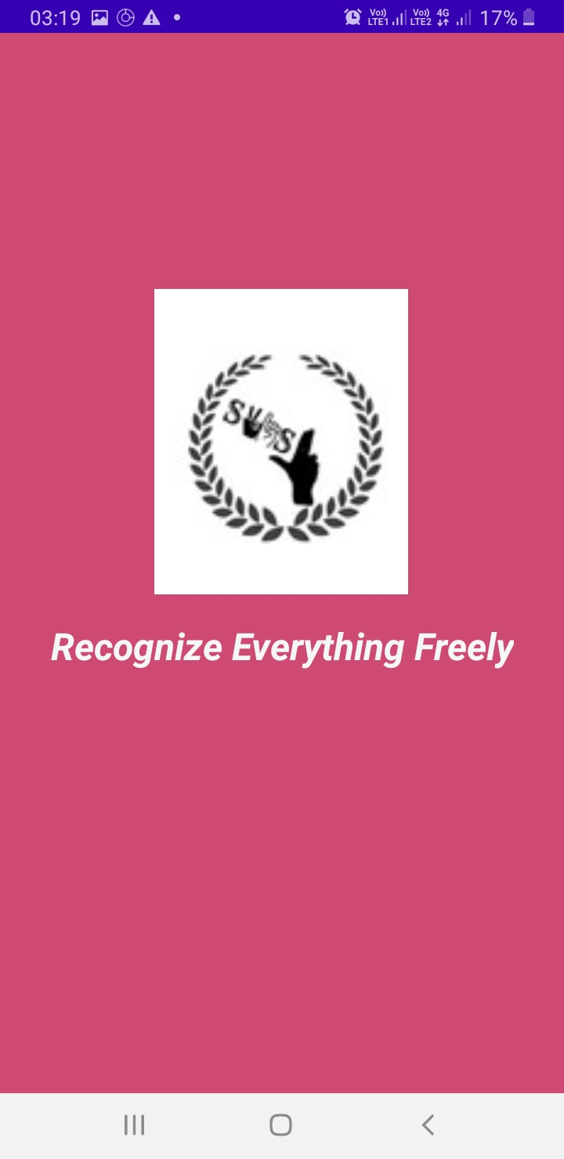
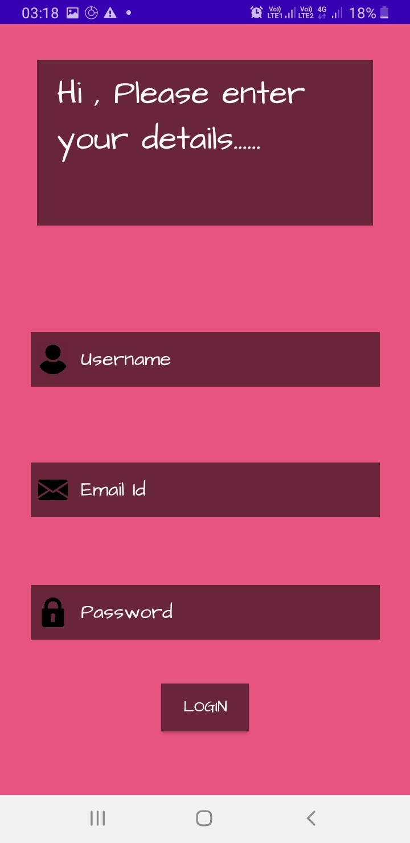
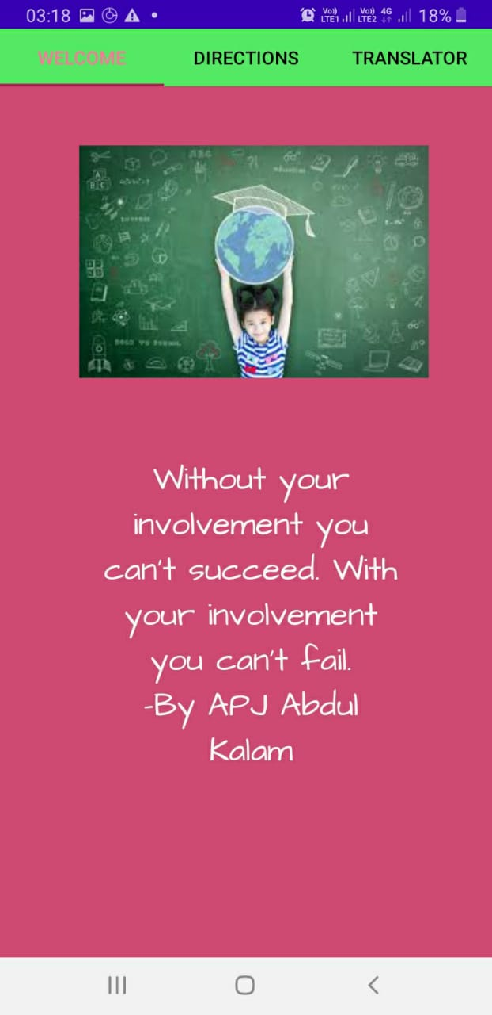
Snapshots of the project

Slide 65
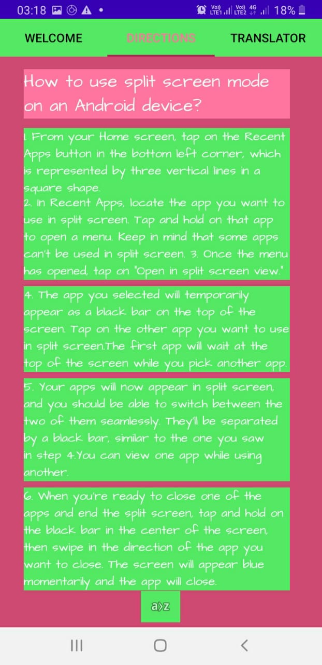
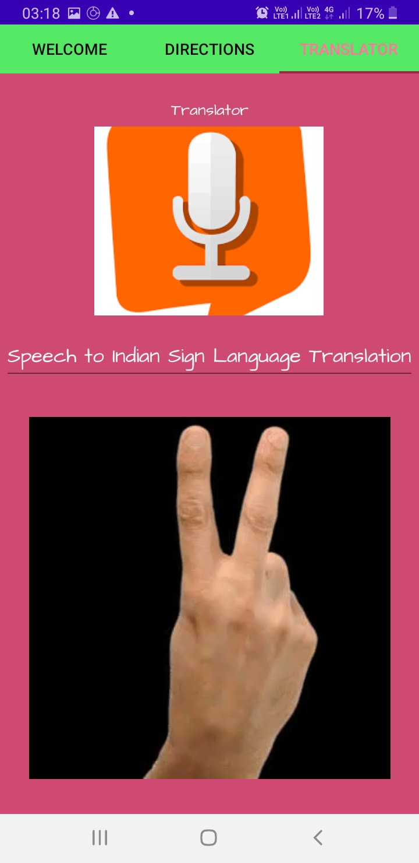
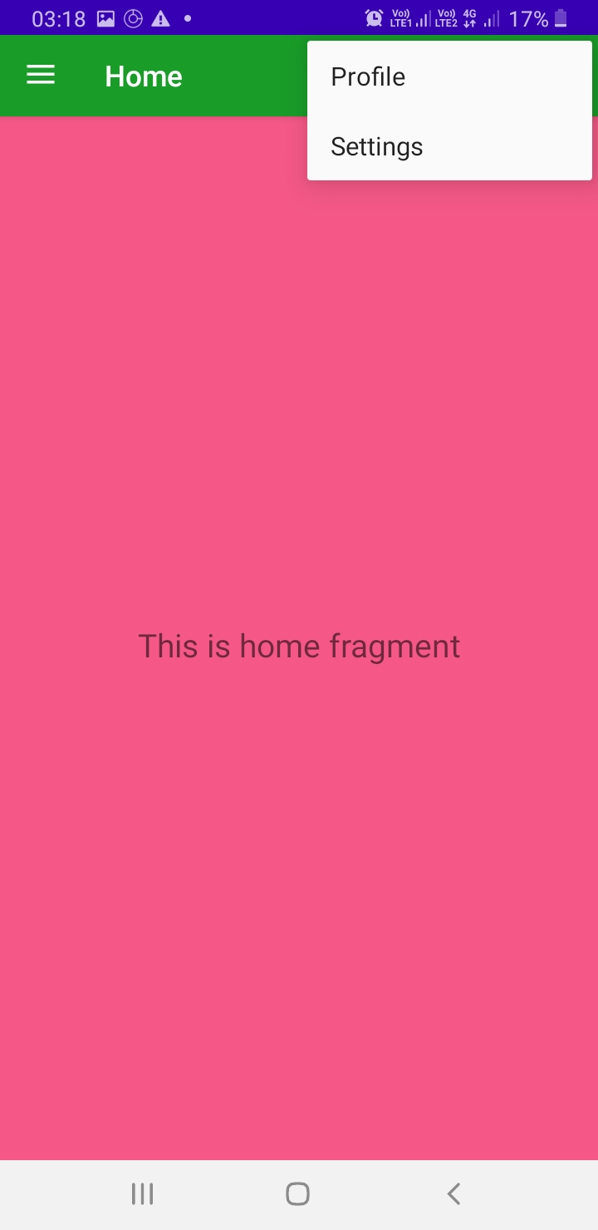

Slide 66
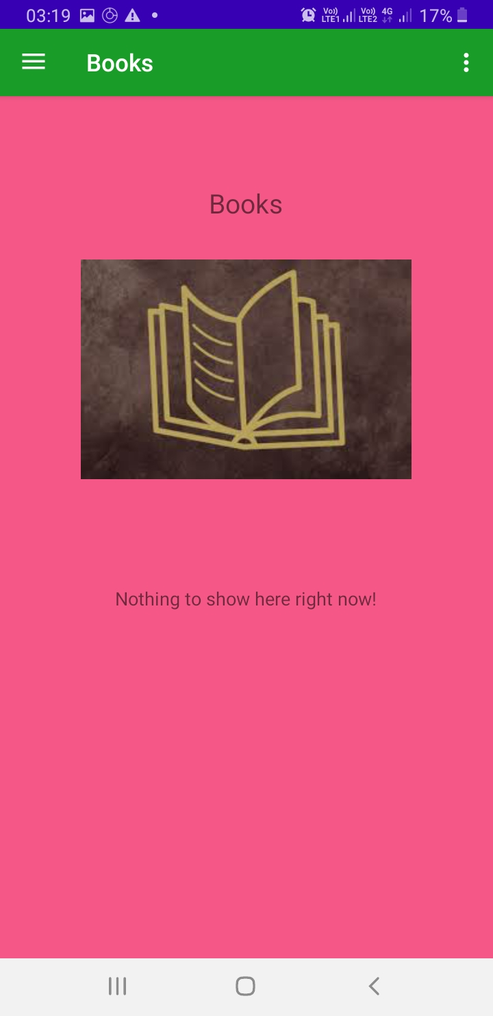
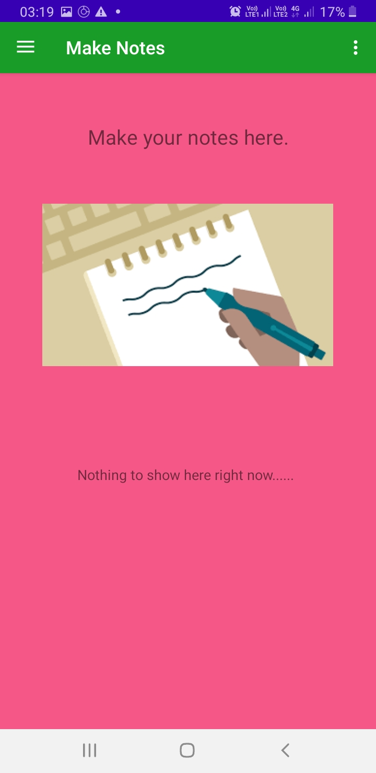

Slide 67
Testing
The app performance is good when we see from the user point of view. It starts with positive quotes which makes oneself feel good. While using the app, clicking its logo it opens and smoothly moves on to the next page. We have to click on “Image Button”in the direction activity(tabbed activity) to move on to the Navigation bar activity fragments. While using the app, it’s simple well guided features helps the user to explore more features into it. A page with a beautiful quote and inspirational quote helps the user to connect with the application. The Translator fragment of the app has been made very well managed. There is an option of split screen view to see the video content and sign language side by side. This really makes an app perform better and understandable. The app performs very well according to the instruction and coding provided. It is well managed with proper scheduled functions and commands. It is easy to understand and use. There is very less percentage of error in the app.
Notes:
t

Slide 68
Testing(2)
Testing of the LSTM Model for Translation
To test the code, we have randomly chosen a sentence from the input_sentences list, retrieve the corresponding padded sequence for the sentence, and will pass it to the translate_sentence() method.
INPUT:-HOW ARE YOU?
OUTPUT:-
Notes:
t

Slide 69
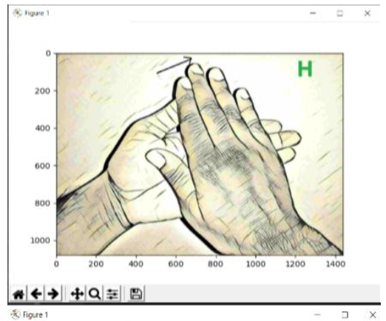
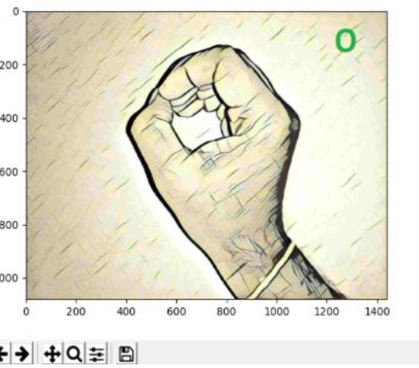
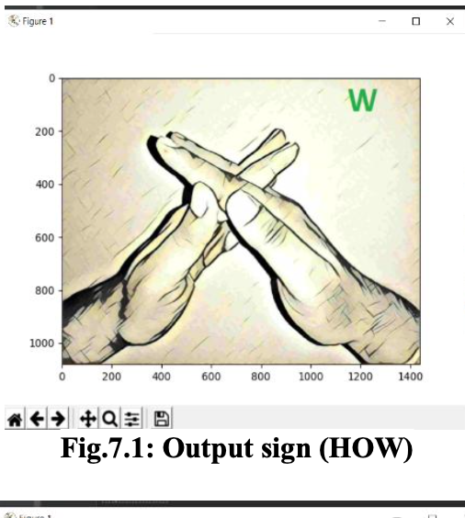
HOW
Output:-

Slide 70
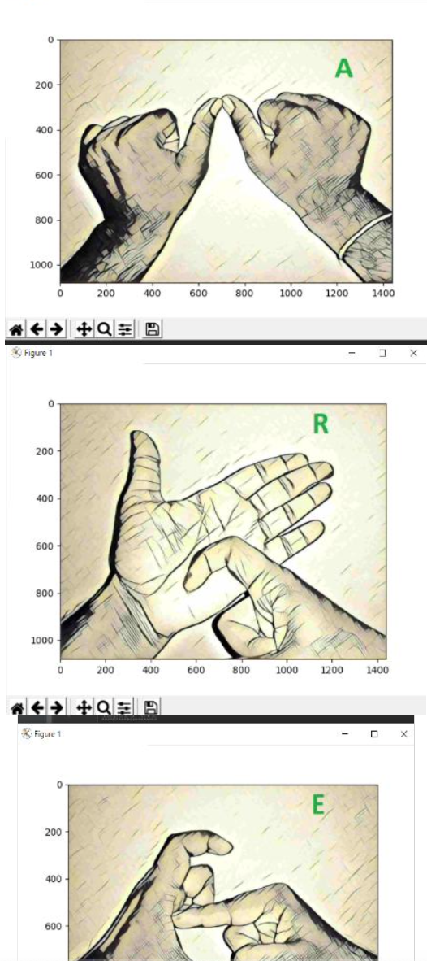
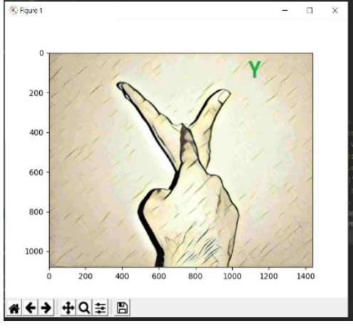
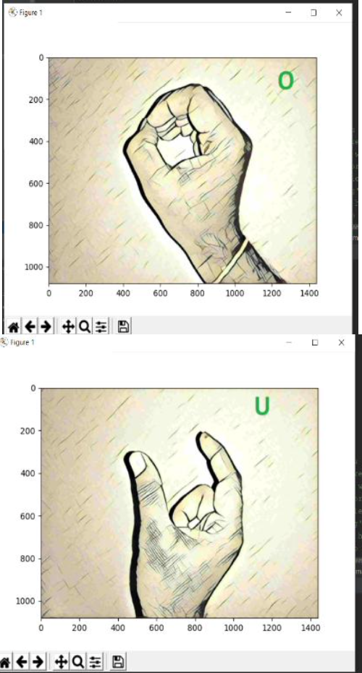
ARE YOU?

Slide 71
RESULT AND DISCUSSION
The system provided by us is a flexible system, easy to use. Proper instructions and graphics have been provided with a decent basic color in the background. As the user completes the login , page with a motivation quote welcomes the user to read instructions to be followed for split screen mode in android and finally the translator is ready to use. Some extra features are also provided in the application like a virtual library to read books and also a fragment to write and save notes.
Notes:
p

Slide 72
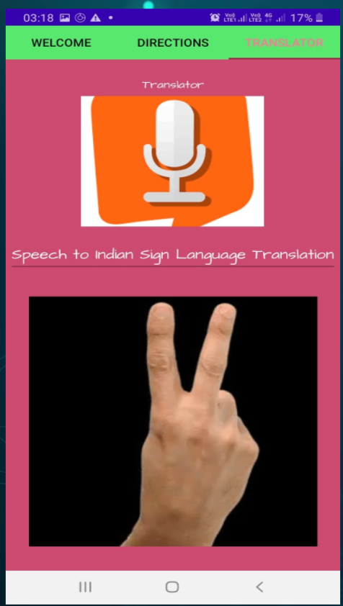
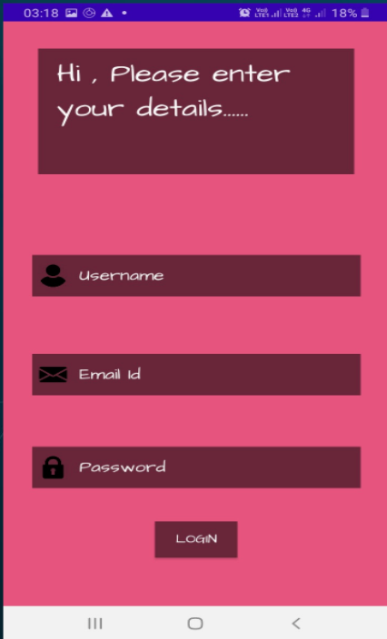
INPUT
LOGIN: logging in the details
PERMISSIONS:-Allowing our app to use audio from the another meeting app.
Pressing the microphone button to start taking input.
Notes:
p

Slide 73
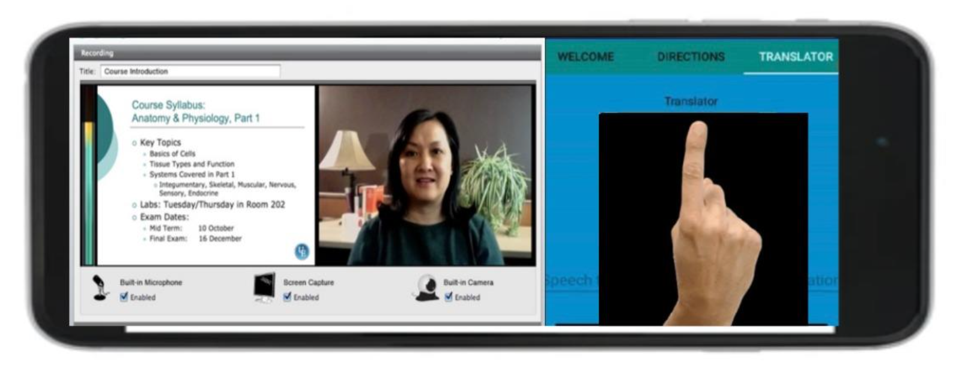
OUTPUT
Translated Indian Sign Language represented through hand movements.
Notes:
p

Slide 74
CONCLUSION
Our app was built on the fact that the online platforms like Microsoft Teams ,Zoom have been given the title of ”online classroom” where the study lectures can take place from the comfort of a home. Although,through ages these platforms were not designed to suit the deaf community. Due to pandemic the whole education has shifted on platforms like these , it has been difficult for the deaf to be able to attend these. Therefore, we made a framework where a deaf student can attend any online lecture or any webinar without having to worry about the translation. We would make it more interactive so they don't feel disconnected from the real process. Our app has achieved some of the above goal. We will enhance some things which will make it much more attractive and effective as well. This app has been made by keeping in mind the fact, why would users use this and how beneficial can he/she be made in order to get a proper chance to enjoy E-Learning.
Notes:
s

Slide 75
CONTRIBUTION OF EACH MEMBER
Prachi Bhatt:
Android application(Log in Activity, Tabbed activity(3 tabs), navigation bar Activity(3 fragments)), Worked on Voice over in demo video ,6 research paper reading, worked on finding best model out of RNN. GRU, LSTM, worked on Translation using google cloud API, worked on word Embeddings (TF IDF) in the LSTM model,worked on report writing. Presentation involvement - 33.3%
Toshini Agrawal:
6 research paper reading, worked on finding best model out of RNN. GRU, LSTM, worked on data preparation, preprocessing and tokenization and padding in LSTM Model(synchronous translation), worked on enabling project on google cloud for translation(Android App development-translator activity), worked on synopsis writing. Presentation involvement - 33.3%
Shivangi Singh: worked on creating splash screen in-app development ,6 research paper reading , worked on finding best model out of RNN. GRU, LSTM Worked on Animation(3D-blender tool ), Worked on the animation in demo video,worked on Report writing , worked on animation for representation module, Presentation involvement -33.3%
Notes:
s

Slide 76


